Slide 1
One-Time Pad Cipher

Slide 2
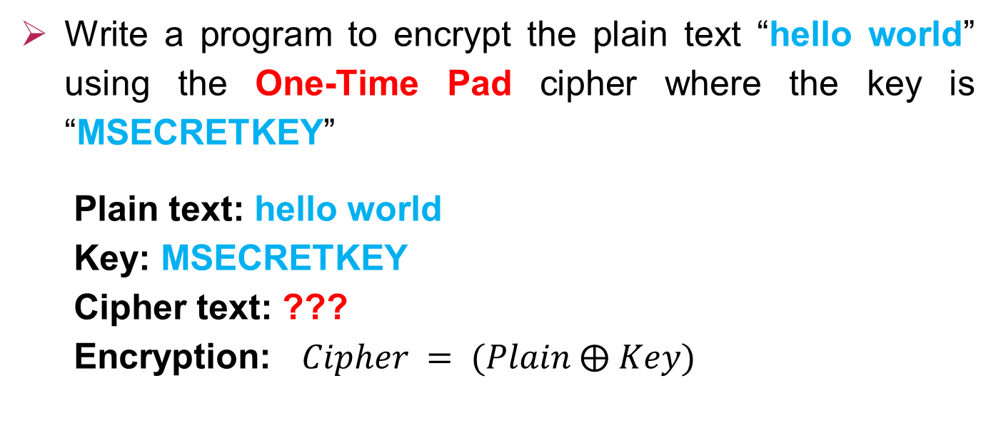
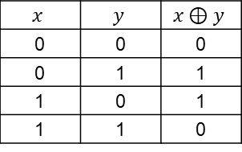
Encryption
Write a program to encrypt the plain text “hello world” using the One-Time Pad cipher where the key is “MSECRETKEY”
Plain text: hello world
Key: MSECRETKEY
Cipher text: ???
Encryption: $Cipher = (Plain ⨁ Key)$
$$x$$ | $$y$$ | $$x⊕y$$
0 | 0 | 0
0 | 1 | 1
1 | 0 | 1
1 | 1 | 0

Slide 3

Plain text
h | e | l | l | o | w | o | r | l | d
104 | 101 | 108 | 108 | 111 | 119 | 111 | 114 | 108 | 100
01101000 | 01100101 | 01101100 | 01101100 | 01101111 | 01110111 | 01101111 | 01101111 | 01101100 | 01101100
Decimal
Binary
Key
M | S | E | C | R | E | T | K | E | Y
77 | 83 | 69 | 67 | 82 | 69 | 84 | 75 | 69 | 89
01001101 | 01010011 | 01000101 | 01000011 | 01010010 | 01000101 | 01010100 | 01001011 | 01000101 | 01011001
$$⨁$$
Decimal
Binary
00100101 | 00110110 | 00101001 | 00101111 | 00111101 | 00110010 | 00111011 | 00111001 | 00101001 | 00111101
37 | 54 | 41 | 47 | 61 | 50 | 59 | 57 | 41 | 61
% | 6 | ) | / | = | 2 | ; | 9 | ) | =
Binary
Decimal
Cipher text

Slide 4
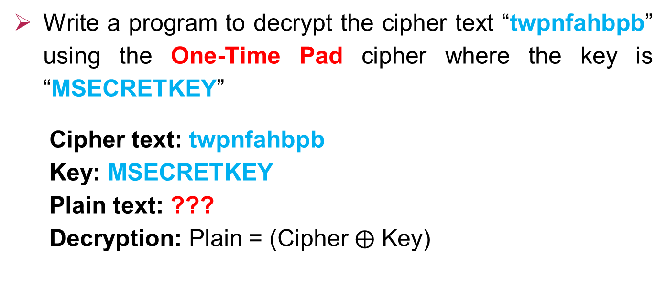
Decryption
Write a program to decrypt the cipher text “twpnfahbpb” using the One-Time Pad cipher where the key is “MSECRETKEY”
Cipher text: twpnfahbpb
Key: MSECRETKEY
Plain text: ???
Decryption: Plain = (Cipher $⨁$ Key)

Slide 5
Thanks!

